Slide 1
Revision

Slide 2
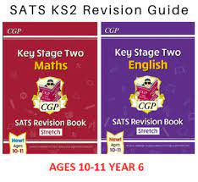
Revision Guides
You will all be given SATs revision guides for both English and Maths on Friday.
These guides are to help you revise and prepare for SATs.
Independent study skills are also really important for Secondary School and will help you to feel confident and prepared for transition.
Your homework until the end of May will be from the revision guides.

Slide 3
Important details
You can choose to buy the revision guides for £4.50 per guide.
If you buy the book, you can write in your revision book as it then belongs to you.
If you choose to not buy the book, you cannot write inside the book. All of your notes and answers will have to be in a separate journal or on paper.
Please treat the revision guides with respect - we will reuse them and so you are only borrowing them.

Slide 4
How to take notes
Repetition, repetition, repetition. Cramming before a test doesn’t work. What does work is regularly reviewing your material.
Pictures are easier to remember than words so if you’re short on time, draw an image.
If you like to colour code, don’t do it during initial note-taking.
Write short.
Save time and use abbreviations and symbols.
Write questions to yourself if there’s something you don’t understand. Don’t gloss over it and hope you’ll understand later.
Don’t try to write everything down. You’ll just get information overload. It’s better to be engaged and have an efficient and effective system of recording the main points.

Slide 5


Slide 6


Slide 7

Examples of note taking

Slide 8
Making a revision timetable
How to get your revision plan right
Be realistic and plan time away from your work to avoid burn-out!
Be focused: 20 minutes working followed by 10 minutes break is a good starting point.
Planning helps you to balance your time so that you don’t spend all your time revising one subject
If you share your revision plan with friends or family then you are more likely to stick to it
Don’t worry about other students’ revision plans, everyone does it differently!

Slide 9
Miss B’s revision timetable example
 | Monday | Tuesday | Wednesday | Thursday | Friday | Saturday | Sunday
Morning | 8.30am School | 8.30am School | 8.30am School | 8.30am School | 8.30am School | 9am - 10am Swimming | 9am - 10am Revision
Afternoon | School 4pm - 4.30 Revision | School | School 4pm - 4.30 Revision | School | School 1.20 - 3pm Revision (at school) 3.30 - 4.30 Hockey
Evening

Slide 10
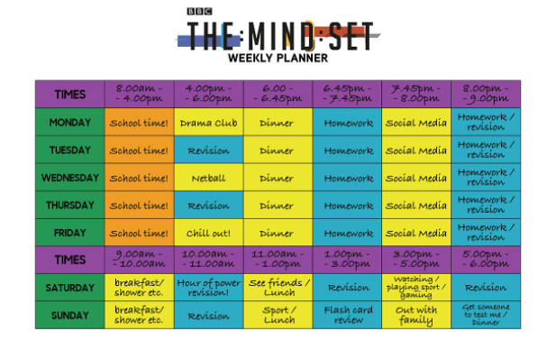

Slide 11
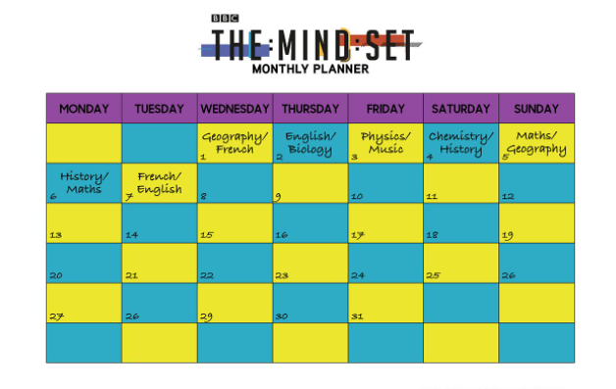

Slide 12
Caleb | 8.30am - 3.15pm | 3.15pm - 4.30pm | 4.30pm - 5.30pm | 5.30pm - 6.30pm | 6.30 - 7.30pm
Monday | School |  |  |  | Revision
Tuesday | School | Football Club |  | Youth group | Youth group
Wednesday | School | Screen | Screen | Revision 5.30pm-6pm
Thursday | School |  | Swimming
Friday | School | Rugby Club
 | 8am - 10am | 10am - 11am | 11am - 12pm | 1pm - 3pm | 3pm - 5pm
Saturday | Basketball club |  | Revision | Play with friends | Play with friends

Slide 13
Walter | 8.30am - 3.15pm | 3.15pm - 4.30pm | 4.30pm - 5.30pm | 5.30pm - 6.30pm | 6.30 - 7.30pm
Monday | School | Revision |  |  | Football training
Tuesday | School | Football club
Wednesday | School |  |  | Football training | Football training
Thursday | School |  |  | Revision
Friday | School |  |  | Revision
 | 9am - 10am | 10am - 11am | 12pm - 1pm | 1pm - 3pm | 3pm - 5pm
Saturday |  | Revision

