Slide 1
Maths in Year 5 and 6

Slide 2
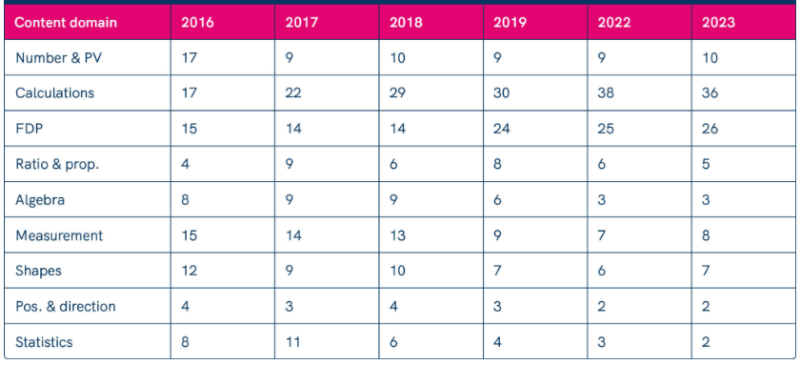
Breakdown for SATs

Slide 3
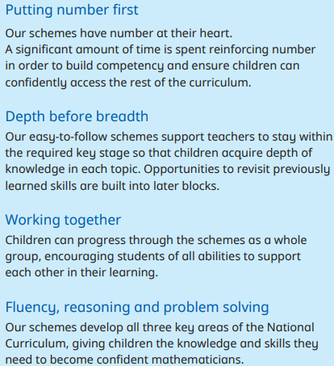
By the end of Year 4 children should be fluent in adding numbers under 10 in their head. They also need to know how to cross the boundary of 10, e.g. 7 + 8.
In Year 5 and 6 children add numbers with more than 4 digits e.g. 23,456 + 11,246.
We continue to build the children’s knowledge of number and deepen their understanding of fluency, reasoning and problem solving skills so they are confident mathematicians.

Slide 4
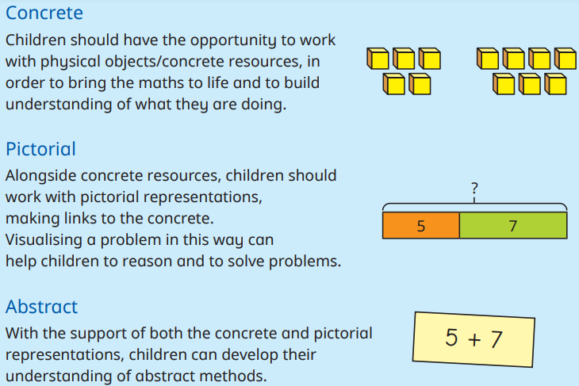
Children are exposed to numbers in lots of different ways and are encouraged as much as possible to ‘see’ the numbers as what they are. E.g. the 5 in 657 is a 50.

Slide 5
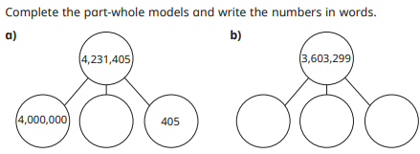
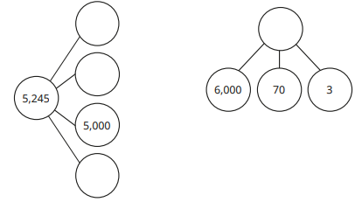
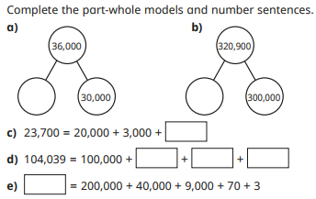
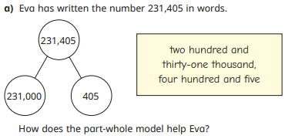
Part Part Whole

Slide 6
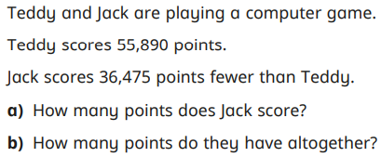
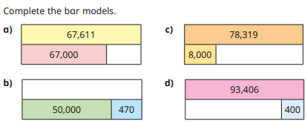

Bar Model
55,890 - 36,475 = 19,415
Teddy- 55,890
Jack
The difference is 36,475 fewer
Teddy- 55,890
Jack- 19,415
The total- 55,890 + 19,415 = 75,305

Slide 7
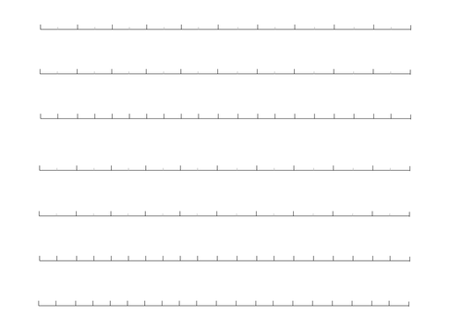
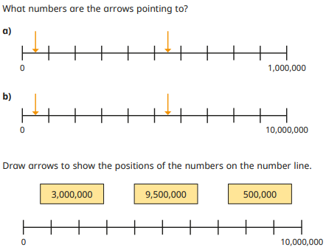
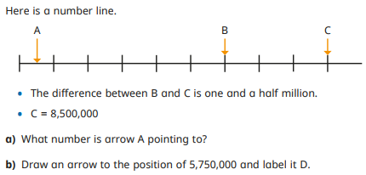
Number lines

Slide 8
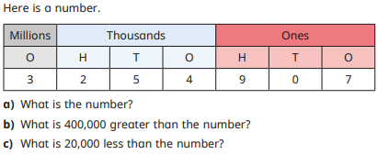
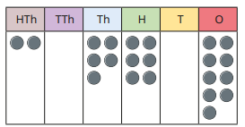
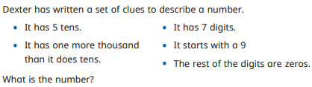
Place Value charts

Slide 9
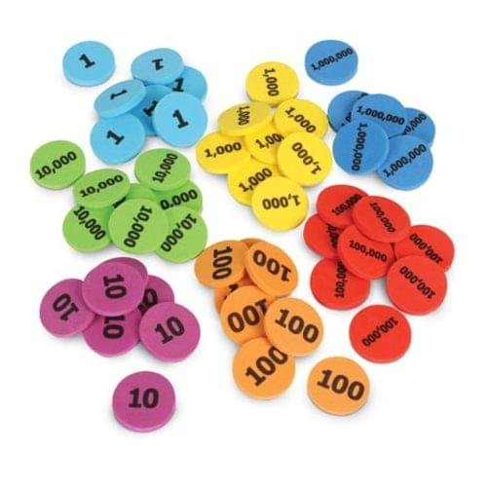
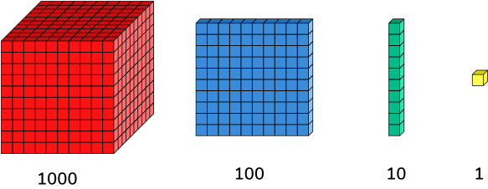
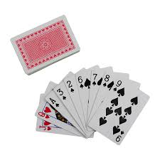
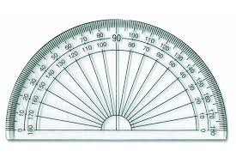
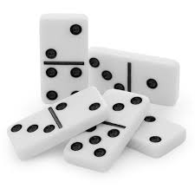
Maths Equipment/boxes
Visual displays
Flipcharts
Handouts

Slide 10
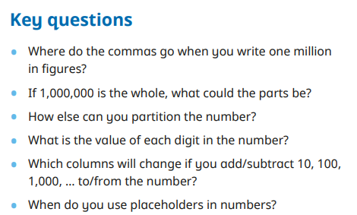
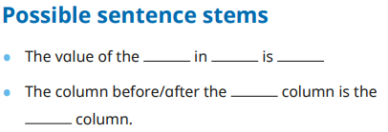
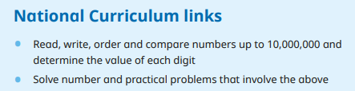
We use key questioning to gauge understanding of the children as well as stem sentences to scaffold their verbal skills to build confidence and support explanations.
These are examples for our Place Value topic. The children might see these on the slides to use in their explanations.
Everything we do, links back to the N.C.

Slide 11
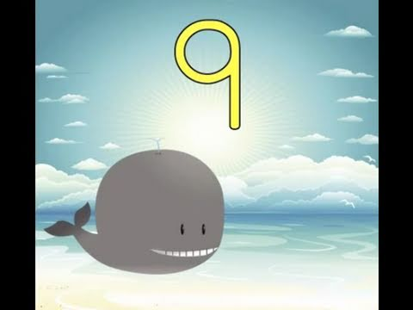
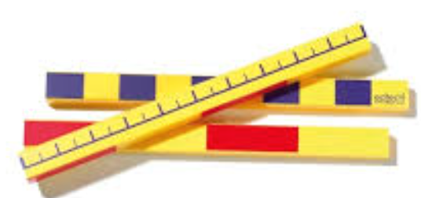
Warm up - Times table practice
Year 5
https://www.youtube.com/watch?v=TcnWKHs9K0E
Year 6
https://www.youtube.com/watch?v=8YWIx-b8NSY
Counting from any given number, up and DOWN
Times tables
Times tables missing numbers, which ones do I need? Which ones do I know from what I have got?
Post it notes/pictures/numbers
Counting in fractions
Counting in decimals
‘If this number is….then what would this one be?’
What would 2 counting sticks be if one is 20?
Hold it horizontally and vertically
Always start on 0 (end of stick)
…use it as a metre stick….

Slide 12
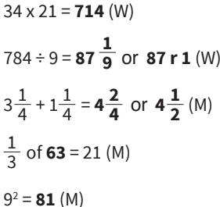
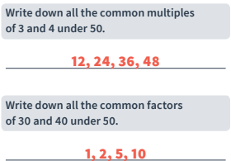
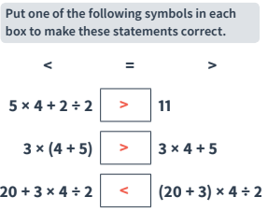

Wk 8- day 3 Fluency and W6 reasoning

Slide 13
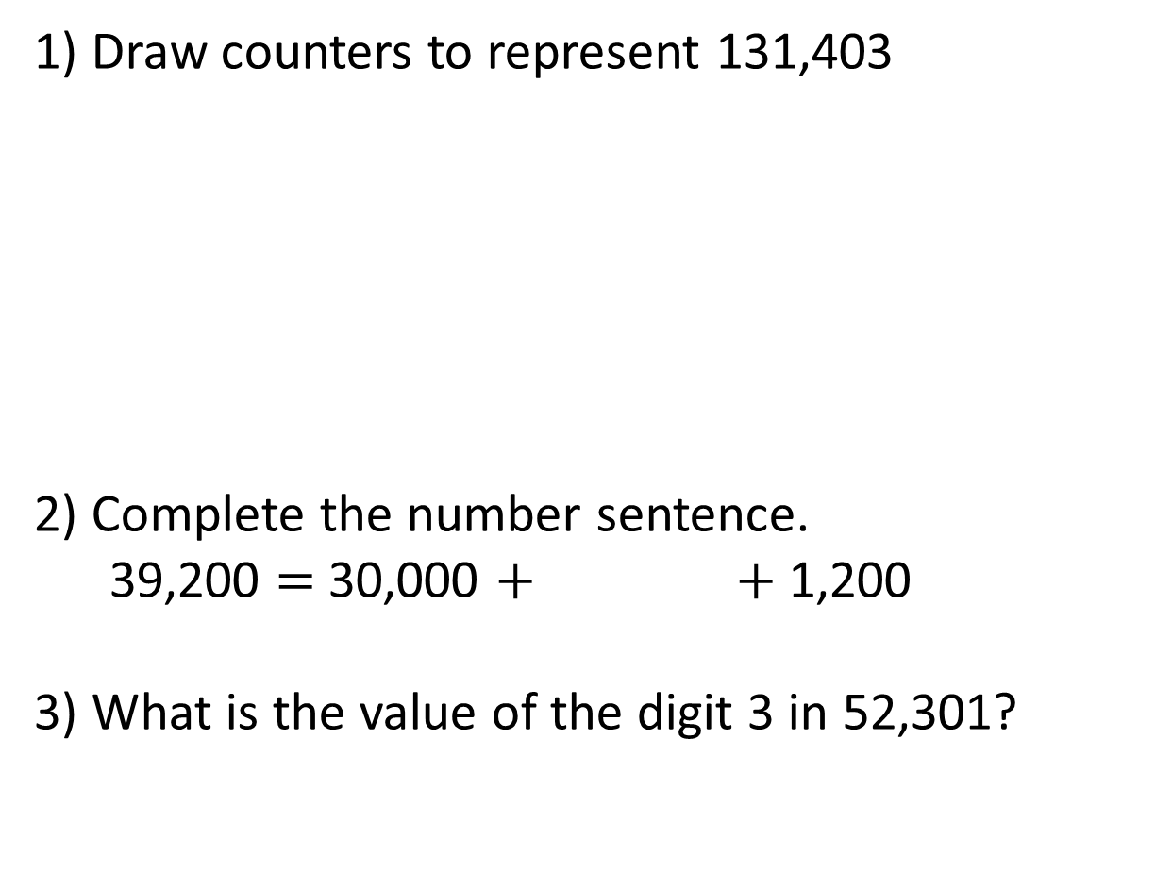
Place Value
HTh | TTh | Th | H | T | O
8,000
Three hundred / 300

Slide 14





Addition
TTh | Th | H | T | O
 |  | 2 | 6 | 5 | 8 | 4
 | + | 1 | 3 | 2 | 3 | 1
3
9
8
1
5
1
3
9
8
1
5
If there are ___or more counters in a column we can make an ________
10
exchange

Slide 15
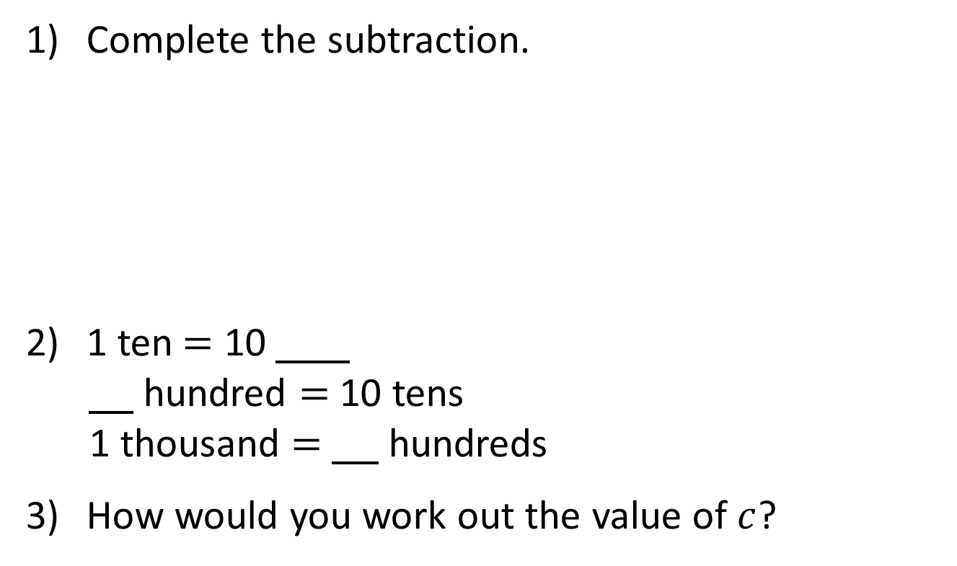
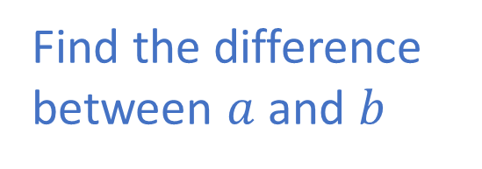




Subtraction
H | T | O
 |  | 6 | 1 | 5
 | - | 2 | 0 | 3
4
1
2
ones
1
10

Slide 16
TTh | Th | H | T | O
 |  | 3 | 6 | 5 | 8 | 2
 | - | 1 | 3 | 2 | 0 | 5
7
1
2
3
3
7
7
2
3
3
7
7
There are not enough ____ , so I need to exchange 1 ____ for 10 _____
ones
ten
ones

Slide 17




 |  | 4 |  | 5 | 5
 | - | 4 | 3 |  | 2 | 6
 |  |  | 6 | 5 |  | 3
9
9
0
0
3
9
0
9
Have a think

Slide 18
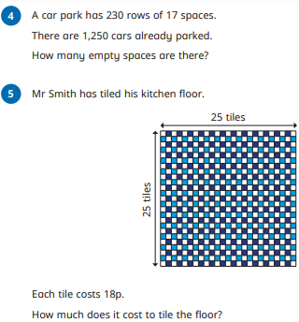
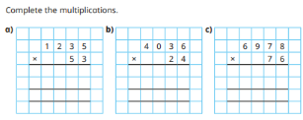
Multiplication
Starting with formal methods and then building in multi-step problems involving more than one operation.

Slide 19
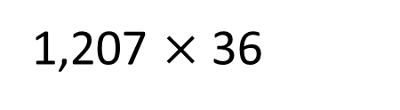
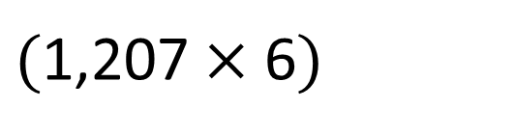
 |  | 1 | 2 | 0 | 7
 | x |  |  | 3 | 6
7
2
4
2
1
1
4
4

Slide 20

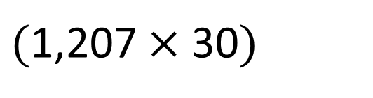
 |  | 1 | 2 | 0 | 7
 | x |  |  | 3 | 6
7
2
4
2
1
4
3
6
2
1
0
2
2
4
3
4
5
2
1

Slide 21



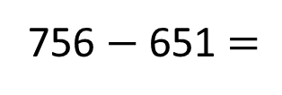
Tommy gets a pack of 12 football stickers every day for 9 weeks.
756
Whitney gets a pack of 21 football stickers every day in August.
651
Who gets the most stickers and by how many?
Tommy gets the most stickers.
105

Slide 22
Th | H | T | O
Have a think
7
8
Th | H | T | O
7
8
0
78 × 10 =
780
Th | H | T | O
7
8
0
0
78 × 100 =
7,800
TTh | Th | H | T | O
7
8
0
0
0
78 × 1,000 =
78,000
What stays the same? What changes?

Slide 23
Have a think
1) To multiply a number by 10 each digit moves
to the left on a place value grid.
1
2) To multiply a number by 100 each digit moves
to the left on a place value grid.
2
3) To multiply a number by 1,000 each digit moves
to the left on a place value grid.
3

Slide 24
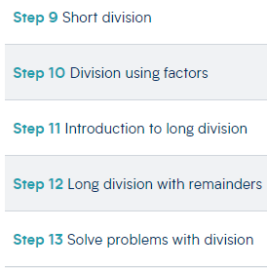
Division
We start with short division both with and without remainders.
We try to show a variety of methods/strategies, discussing how efficient they are, however we ask the children to pick the method they are most comfortable with.

Slide 25
4,884 crayons are grouped into packs of 4
How many packs are there?
Thousands | Hundreds | Tens | Ones
4 | 4 | 8 | 8 | 4
1
2
2
1
1,221 packs
How many groups of 4 thousands are there in 4,000?
How many groups of 4 ones are there in 4?
How many groups of 4 hundreds are there in 800?
How many groups of 4 tens are there in 80?

Slide 26

There are 349 people at a wedding. They are sitting at tables in groups of 8
How many tables are needed?
 | 8 | 3 | 4 | 9
0
4
3
r5
3
2
Another table is needed to seat those 5 people so 44 tables are needed.
Have a think
43 tables are needed.
r 5 represents 5 people at the wedding.
Do you agree with Tiny?

Slide 27

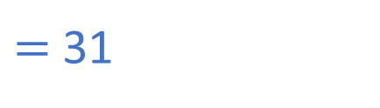


19
38
57
76
95
114
133
152
171
190
19 | 5 | 8 | 9
3
1
58 tens divided by 19 is equal to 3 tens with a remainder of 1 ten.
The remainder is exchanged into 10 ones.
5 7
9
1
1 9
19 ones divided by 19 is equal to 1 one.
0

Slide 28






Eva needs 540 pencils for all her art lessons this year.
Pencil Palace
22 pencils
£2.50
22 | 5 | 4 | 0
2
4
25 packs
24 r12
4 4
0
1 0
8 8
22
44
66
88
110
132
1 2

Slide 29


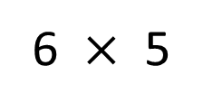

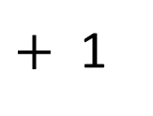
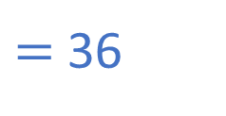
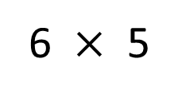
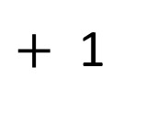
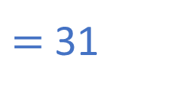
Bidmas
In mixed order calculations, calculations are not always carried out from left to right.
brackets
Priority
Powers
Which operation has greater priority?
Have a think
6
30

Slide 30
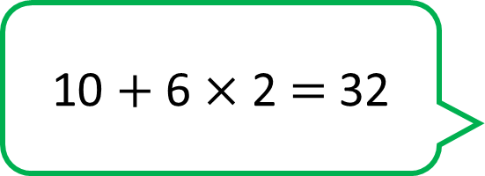


brackets
Powers
Do you agree with Tiny?
Have a think

Slide 31
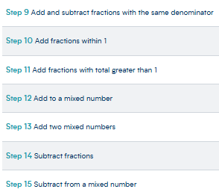
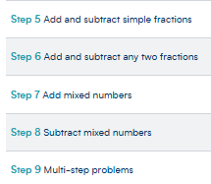
Fractions with different denominators-
There are similarities across the curriculum in Year 5 and Year 6, however one main difference is that in Year 5, you only have to change one of the denominators in order to complete the calculation.
Year 5 Year 6

Slide 32

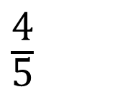







Dexter eats of his chocolate bar.
Alex eats of her chocolate bar.
Do they eat more than 1 whole chocolate bar altogether?
Yes
1

Slide 33
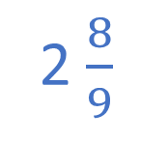













2
2
I will use equivalent fractions to help me.
I am going to make all of the denominators 9

Slide 34







Have a think
Multiples of 10: 10, 20, 30, 40
Multiples of 4: 4, 8, 12, 16, 20, 24, 28, 32, 36, 40

Slide 35









Slide 36
Helpful websites to support Maths at home-
https://whiterosemaths.com/resources?year=year-6-new
This website is a great resource for parents and children. In the home learning section it has helpful videos on possible methods the children could use to solve a problem and on the page I have shared there are a number of free workbooks which are broken down by topic area.
https://corbettmathsprimary.com/5-a-day/ - Arithmetic style 5 a day questions. They can test their knowledge and challenge themselves with the bronze, silver, gold and platinum questions. It does have the answers also.
https://www.bbc.co.uk/bitesize/levels/zbr9wmn Bitesize are always helpful for all subjects but can focus more on spelling and grammar.
https://www.novaprimaryacademy.co.uk/page/?title=Year+6+SATs+revision&pid=180
https://uk.ixl.com/maths

