Slide 1
Year 6 The year ahead
Autumn term

Slide 2

Welcome from the Year 6 team!
Mr Donhou- Violet class (Year 6 Lead).
Supported by Mrs Louise Noonan and Miss Izzy Hooton/ Mr Fox Benwell
Mr Davies- Lavender class.
Supported by Ms Lisa Jordan
Miss Brown- Lilac class.
Supported by Ms Jayne Spence

Slide 3
Our aims for the school year
To create a memorable final year of Primary education for the children.
To ensure that all children are well-prepared for the transition to secondary school.
To deliver the curriculum in an engaging and exciting way which motivates our students. We will also look to offer the children lots of opportunities to learn new skills and enjoy new experiences.

Slide 4
How a day might look
8.40 - Classroom open to students
8.45 - Registration and Early Morning Task
9:00 - Assembly (Mon, Weds, Fri)
9.30 - Maths
10.30 - Reading
11-11.20 - Break
11.20 - English
12.20-13.20 - Lunch
13.30 - Topic/PE/Art/Science/PHSE/Computing etc
15.10 - Hometime
Note- two sessions of PE throughout the week, brain breaks will also be slotted in accordingly.

Slide 5
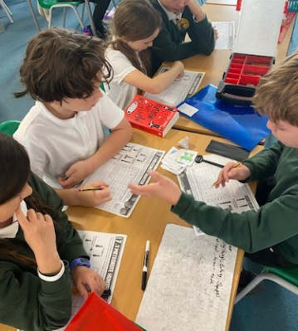
Topics
Autumn Term- Epic Earth- the wild and the wonder
Geography/History topic which examines extreme biomes. To begin, our challenge is to design our own version of the Eden Project for Oxfordshire that we can send to the Oxford tourist board to convince them this is what they need.
Spring Term- Movers and Shakers: People and ideas that changed the world
This topic develops children’s understanding of what makes someone inspirational. We will be looking at a range of inspirational people from a variety of fields.
Summer Term- The Mysteries of the Maya
History topic which focuses on the Maya Civilization.

Slide 6
Homework
Your child will be given a piece of Maths, English and Spelling each week. Homework is given every Friday to be completed by the following Wednesday. We will start this in Week 2. In addition to this, we expect children to be reading daily (Reading Karate scheme) and spending 5-10 minutes on TTRS (Times Table Rock Stars).
This should be a consolidation of their learning throughout the week as we encourage children to be independent learners. We mark homework following submission.
This homework will be available online through Google Classroom. The children have been shown how to use GC. This allows the children to access their account both at home and within school.
Paper copies are also available on request. Link to the website below for GC.
https://www.windmill.oxon.sch.uk/page/?title=Google+Classroom&pid=132

Slide 7
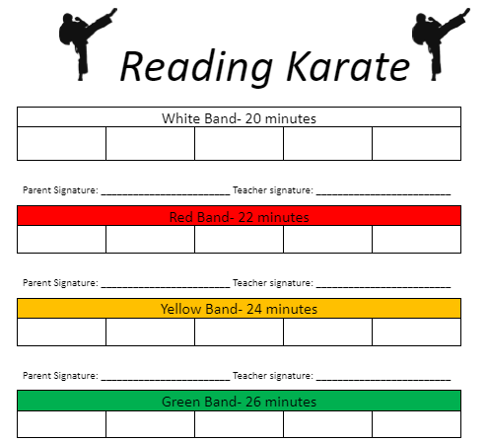
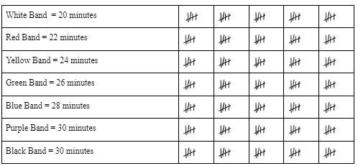
Reading Karate
In addition to the homework, it is expected that your child reads daily. Reading Karate is our reading incentive scheme where children are rewarded with different colour wristbands according to how often they spend reading.

Slide 8
Interventions
Targeted adult support takes place within the classroom, as required.
Selected children will have one to one reading sessions with adults.
There will also be booster groups in the afternoons.
Extra support with class teachers will take place during registration and assembly times.

Slide 9
SATS
SATs- Monday 11th May- Thursday 14th May
Maths: One Arithmetic- 30 mins, 2 x Reasoning papers - 40 minutes.
SPAG- The children will be tested on their spelling and knowledge of punctuation and grammar. One spelling test- 20 words, one SPAG test- 45 minutes
Reading test- 1 hour.
Writing is teacher assessed and in order to achieve ‘Working at expected level’ or ‘ARE’ your child must meet 100% of the objectives.
Science is also teacher assessed and takes into account children’s scientific knowledge and their ability to work scientifically.
Could we ask that previous SATs papers are not tested at home as we use these throughout the year for assessment- we’ve had tutors using them in the past.

Slide 10
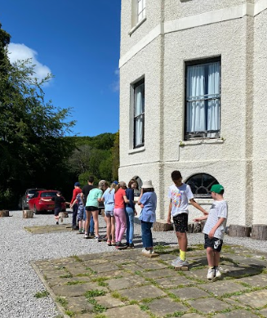
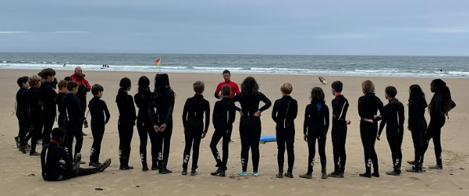
Kilvrough- 22nd to 26th June
Kilvrough is a converted Georgian Manor House located in South Wales.
It is a brilliant opportunity to make fantastic memories and develop key skills which will benefit them in their transition to secondary school.
Gives children a chance to try new activities and sports in a safe environment with trained and dedicated instructors.
There will be a Kilvrough meeting for parents later in the year and information regarding the trip will be shared in the near future- letters on payment/kit lists/medical forms. The cost of this trip will be around £375, however financial concerns should never be a barrier to your child coming on the trip.

Slide 11
Science Oxford Trip
We have organised a Year 6 trip to the Science Oxford - the trip will take place on Friday 10th October.
On the day we will be leaving school in the morning to arrive at 9.45am. We will be back at Windmill before the end of the school day, therefore dropping off and collecting your child will be as normal at 8.40am and 3:10pm.
Children will need to bring a packed lunch. If you have registered with the office for your child to have a benefits-related free school meal, a packed lunch will be provided by the school.
Other trips coming up- letters will be sent out at a later date.
IMPS training at the Radcliffe Hospital.

Slide 12
Communication
Termly provision maps will be shared through the website, as will important events and key dates.
Notices and reminders will also be shared through via email through parent reps, Seesaw or the Windmill app. Paper copies may also be handed out. Google classroom is for homework/class learning.
- To contact your child’s Class Teacher, please use the emails below.
Michael Donhou (Year group Lead): mdonhou@windmill.oxon.sch.uk
Jon Davies: jdavies@windmill.oxon.sch.uk
Emily Brown: ebrown@windmill.oxon.sch.uk
- Any absences for you child, please contact the school office.

Slide 13
Housekeeping
Please ensure all children are wearing appropriate school uniform (black shoes or trainers) and are bringing in an appropriate snack- this should be a fruit or yoghurt snack to eat at break time.
•LABELLING – Please label all your child’s clothes, bags, lunchboxes and PE shoes with a surname and class name. Remember to do this for new purchases. Sharpies work just fine.
•PACKED LUNCH/SCHOOL DINNER – Your child should have one or the other.
On trips, only those children who get Free School Meals have a school lunch provided.
•INSTRUMENTAL LESSONS – Your child will receive their timetable.

Slide 14
Secondary school open days
Application to Secondary schools in now open.
Throughout the year there will be many open mornings or evenings for the different secondary schools.
We encourage this, but can we ask that you let your class teacher and office know when you plan on visiting.

