Slide 1
Year 6 Parent Meeting
Friday 21st November 2025

Slide 2
Aims of the meeting
Discuss the trip to Kilvrough.
Give you opportunity to ask any questions you have about Kilvrough- I will save time at the end to go through these.
Discuss the letters- These will have been sent home with your child today.

Slide 3
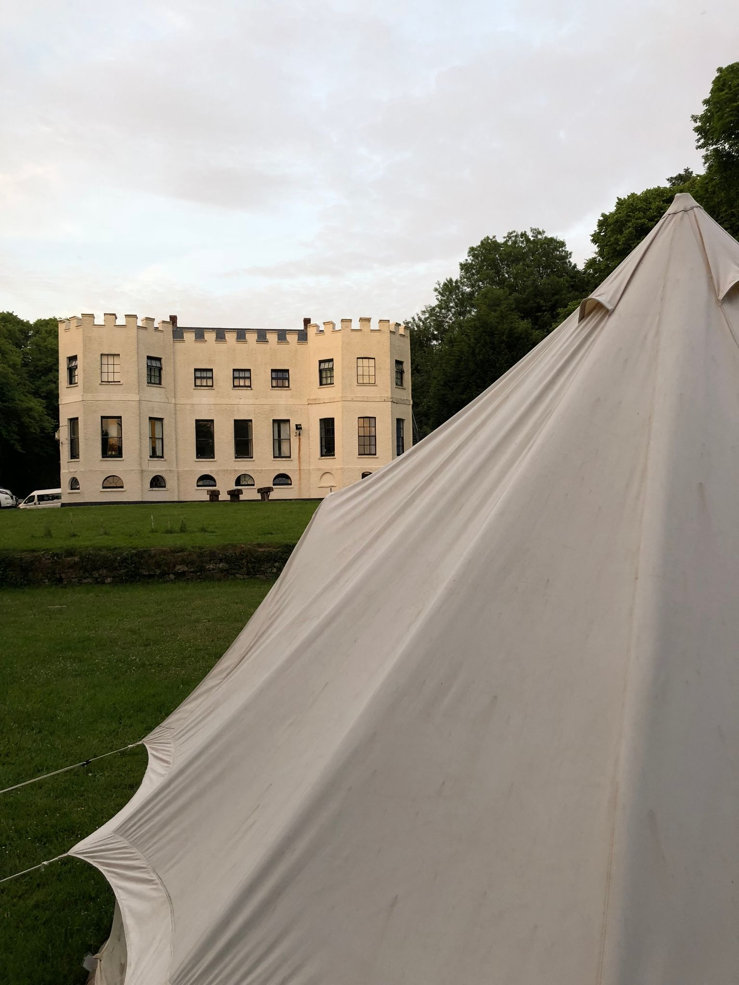
Kilvrough 2026
Monday 22nd June 2026 - Friday 26th June 2026
Leave school early in the morning - Coach departure at approx 7.45am. (Times given closer to the time)
Children to arrive at approx 7.15am.
Return to school at around 6pm on Friday (coach leaving Kilvrough at 3pm).

Slide 4
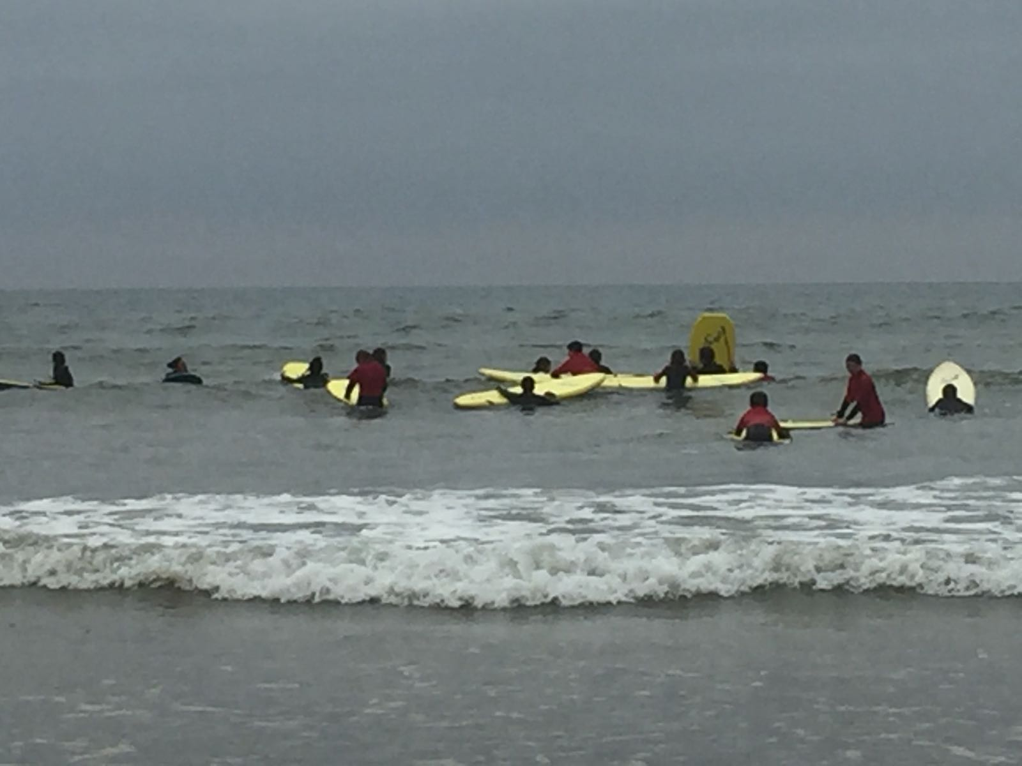
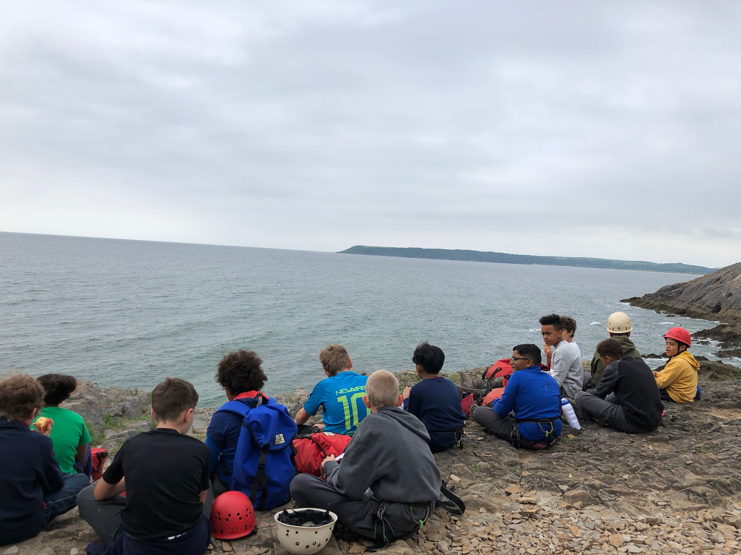
What do we do?
Day One - Settling in, problem solving and team building activities.
Days 2, 3 & 4 - Mixture of bodyboarding/kayaking, caving and climbing/abseiling.
Day 5 - Morning activities before travelling back in the afternoon.

Slide 5
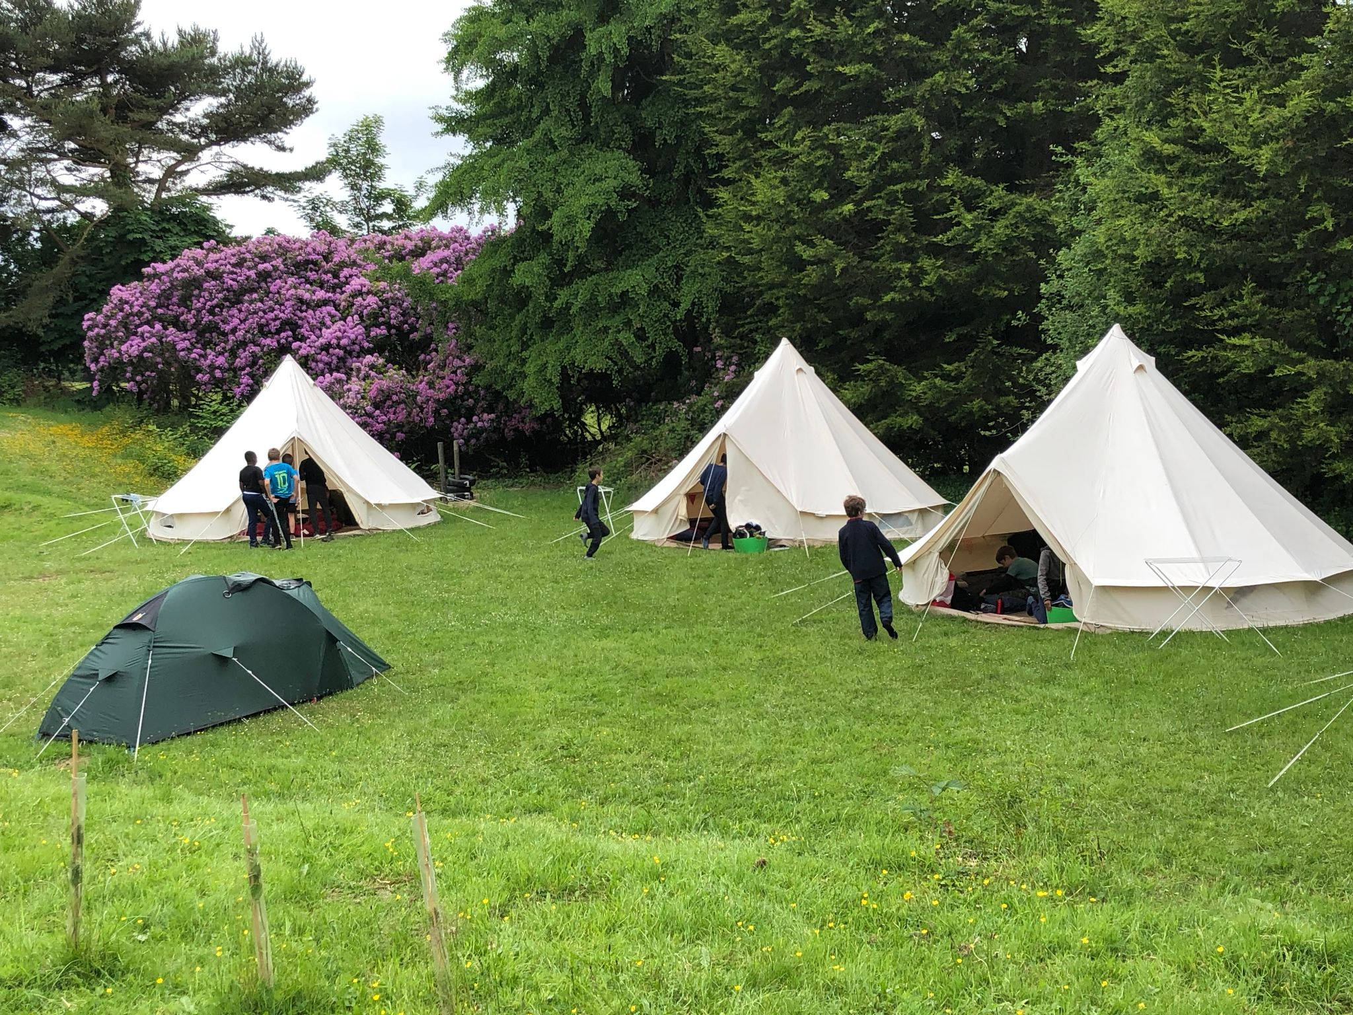
Accommodation
Some children will be in single-sex dormitories in the main building. These range from 4-bed to 9-bed dorms.
Others will be in tents outside. These are usually 7/8 person bell tents, which will be next to the main building.
Staff will be in both locations.

Slide 6
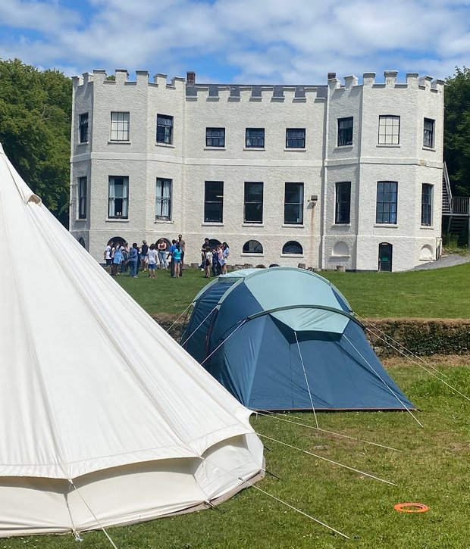
Food
The food has always been good and plentiful in our experience.
If your child has any dietary requirements then this needs to be in the forms that will come to you soon. If your child has halal food, please can you add this to the form.
Fruit is always available.
No one has ever gone hungry (even the fussiest eaters!)
Packed lunches are provided on day 2-5. Children will need to bring a packed lunch for the first day.

Slide 7
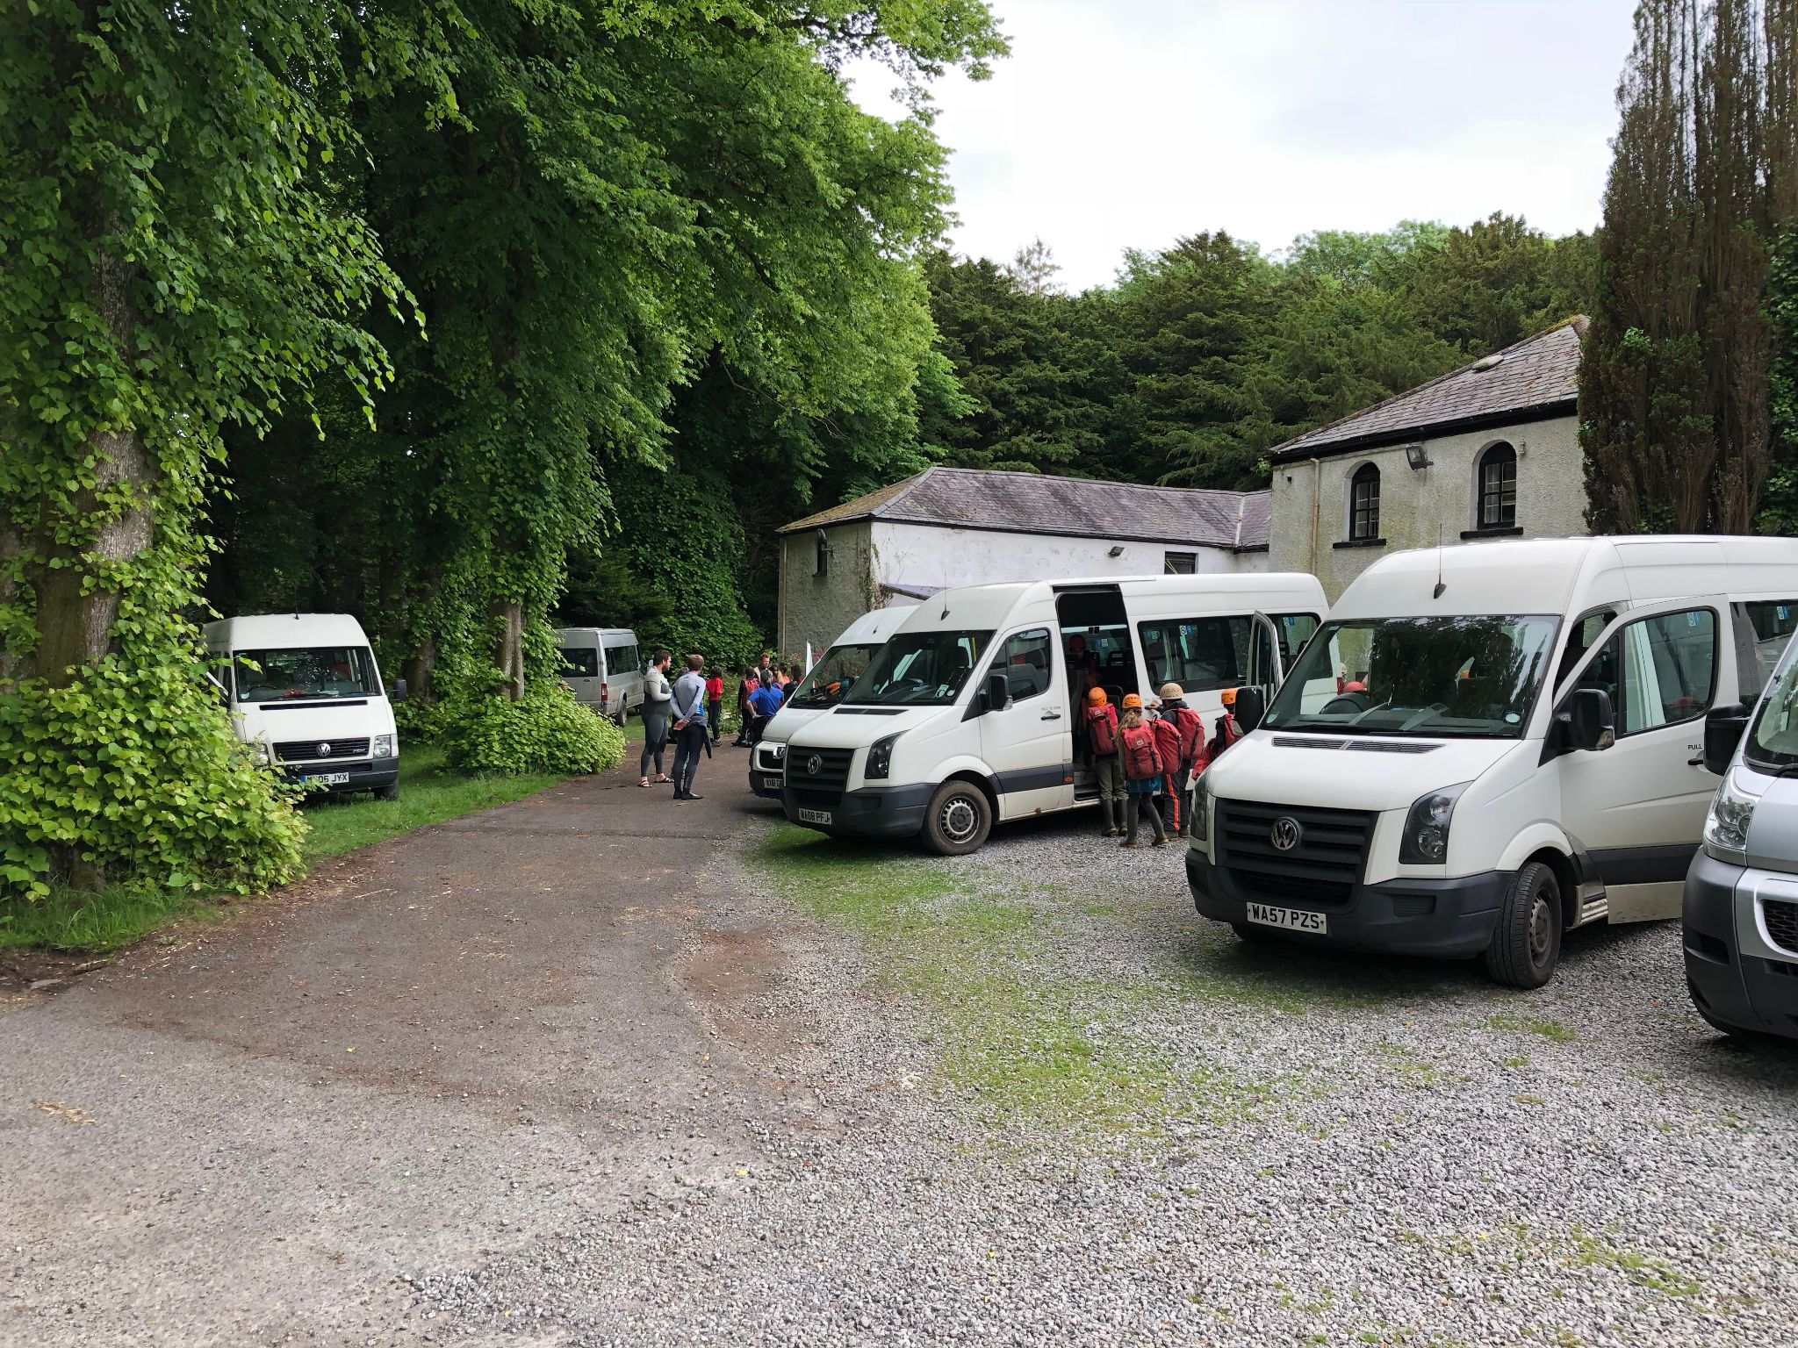
Equipment
Kilvrough provide ALL specialist equipment.
A kit list will be send out with the consent form.
Whatever the weather forecast, please pack for all eventualities.
Children do NOT need “good” clothes! All clothes worn out on activities are likely to get wet and muddy!

Slide 8
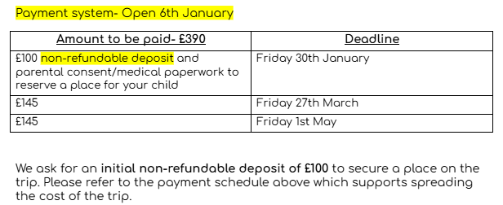
Finances- £390
Note, you can’t pay all in one go, however if you wish, you can make 3 payments from January.

Slide 9
Medication
If your child has any medication, we are able to administer this providing we have the correct permissions.
This does include travel sickness tablets. Please state these on the forms.

Slide 10
Next steps
Online payments from January (see the letter for details).
The next parent meeting about Kilvrough will be Friday 13th March 2026 - 2.30pm in person (Violet class). Kitlists and medical forms will be sent out on this day.
Dorm/tent choices will be made in May.

Slide 11
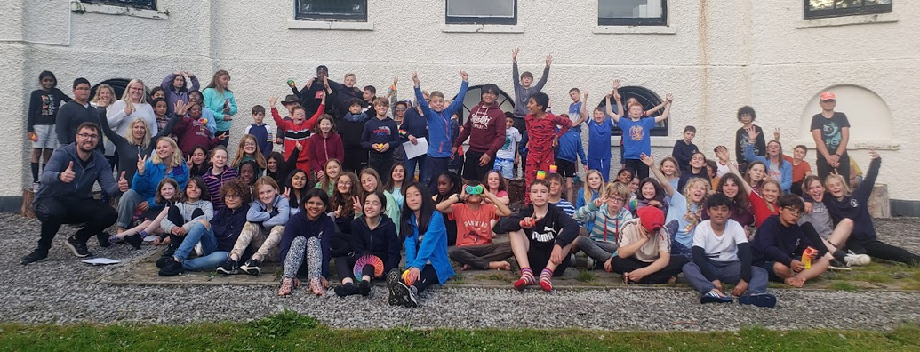
Any questions?

