Slide 1
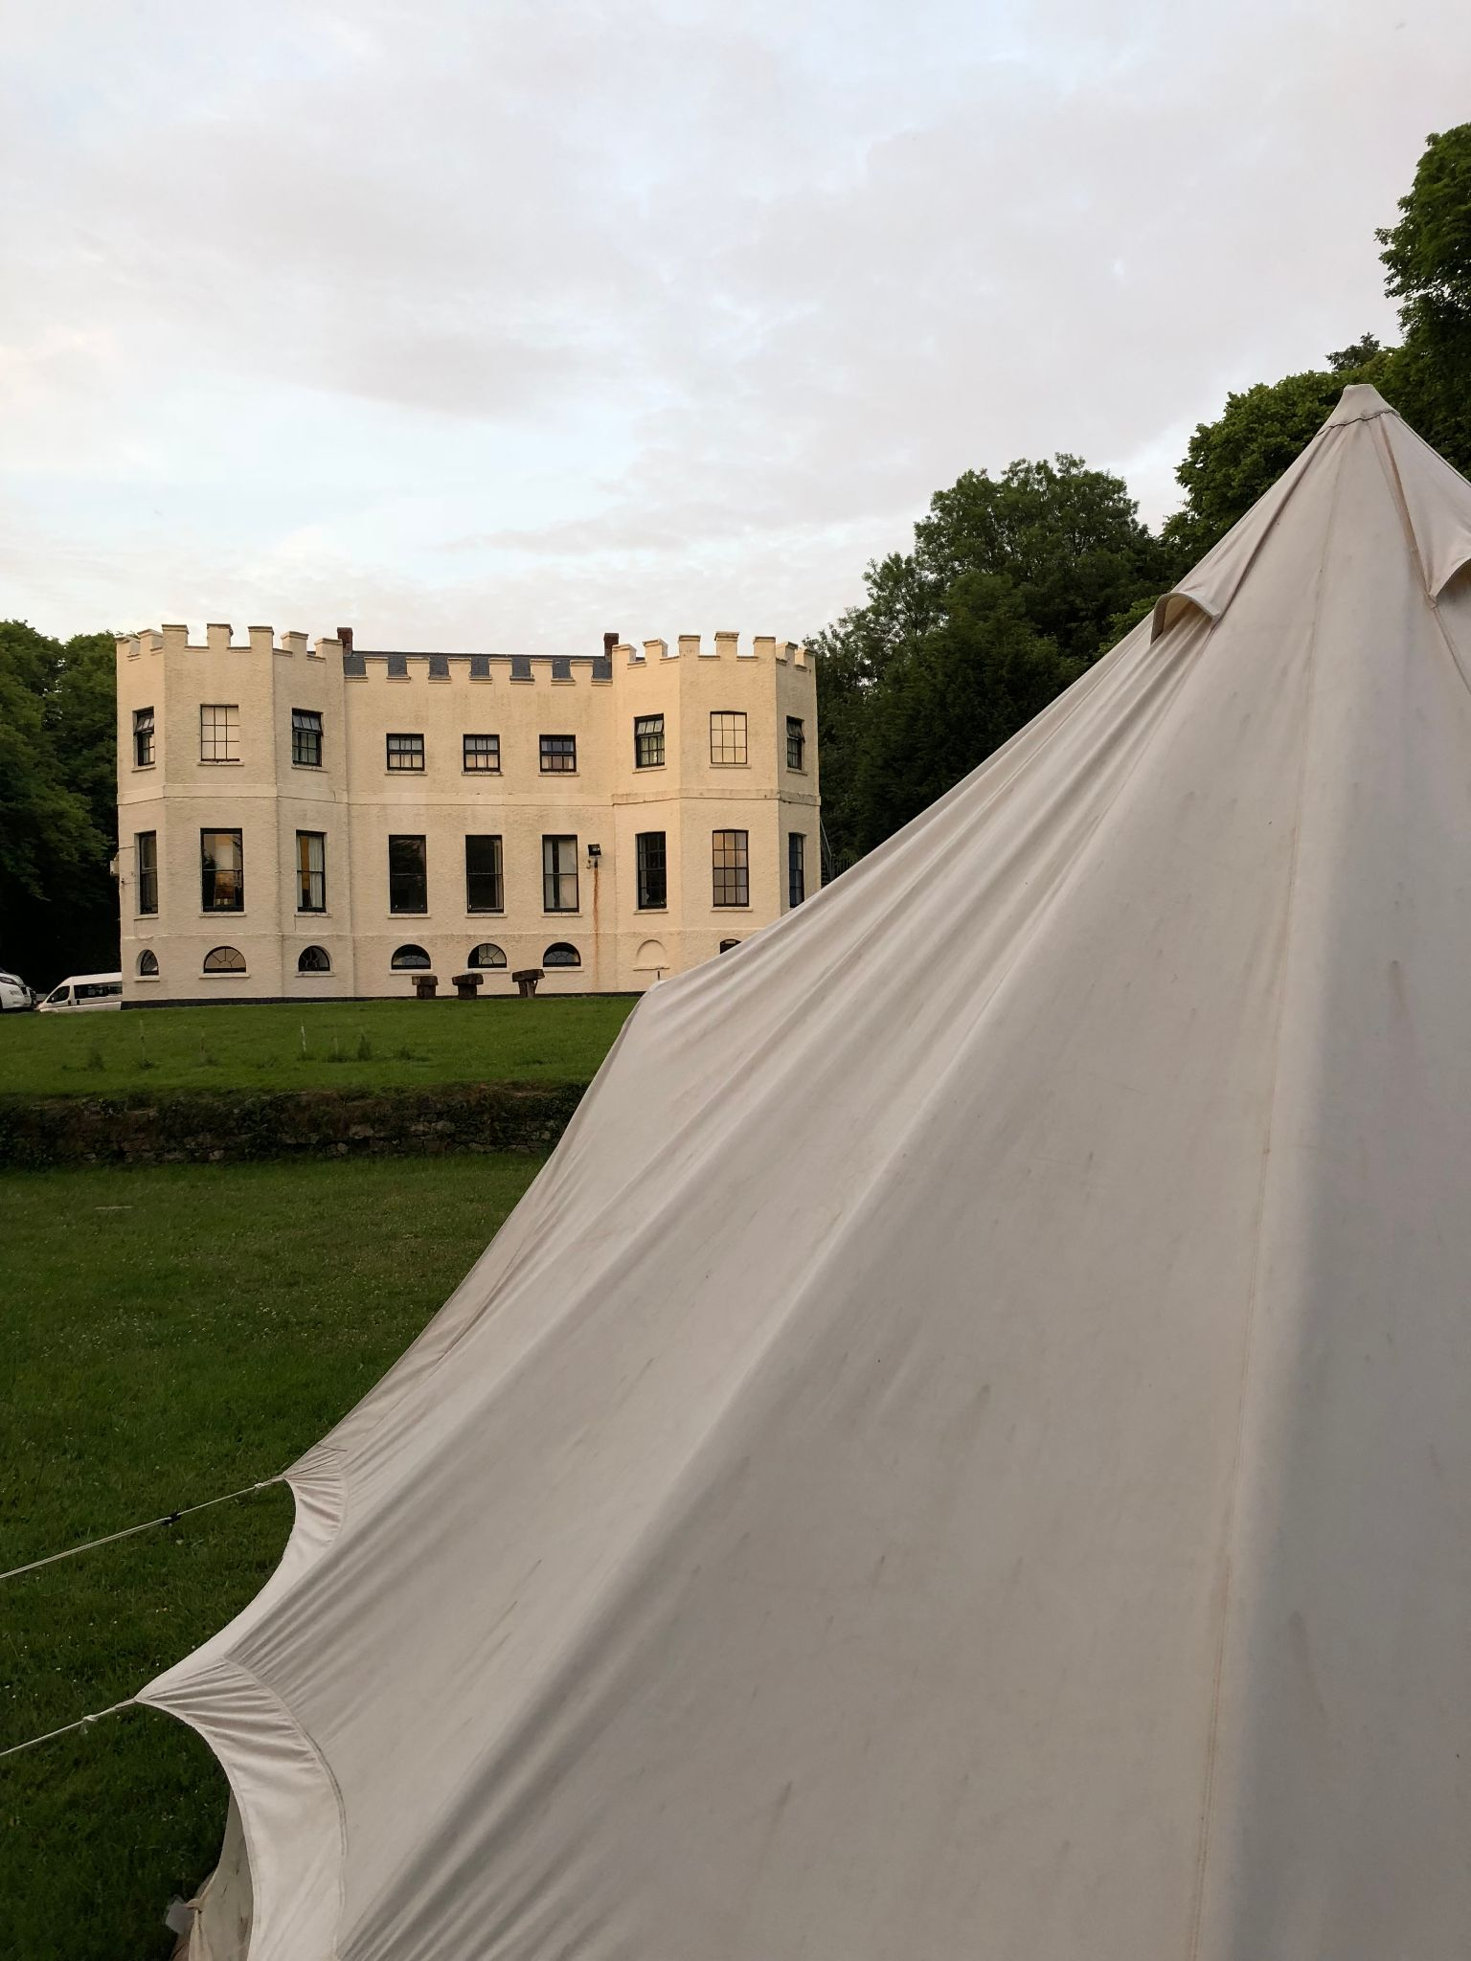
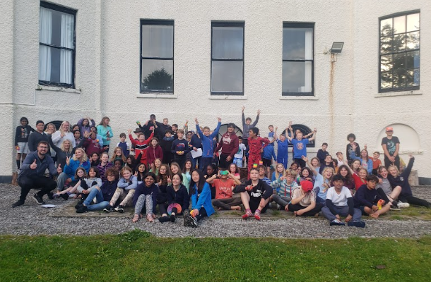
Kilvrough 2026
Monday 22nd June 2026 - Friday 26th June 2026

Slide 2
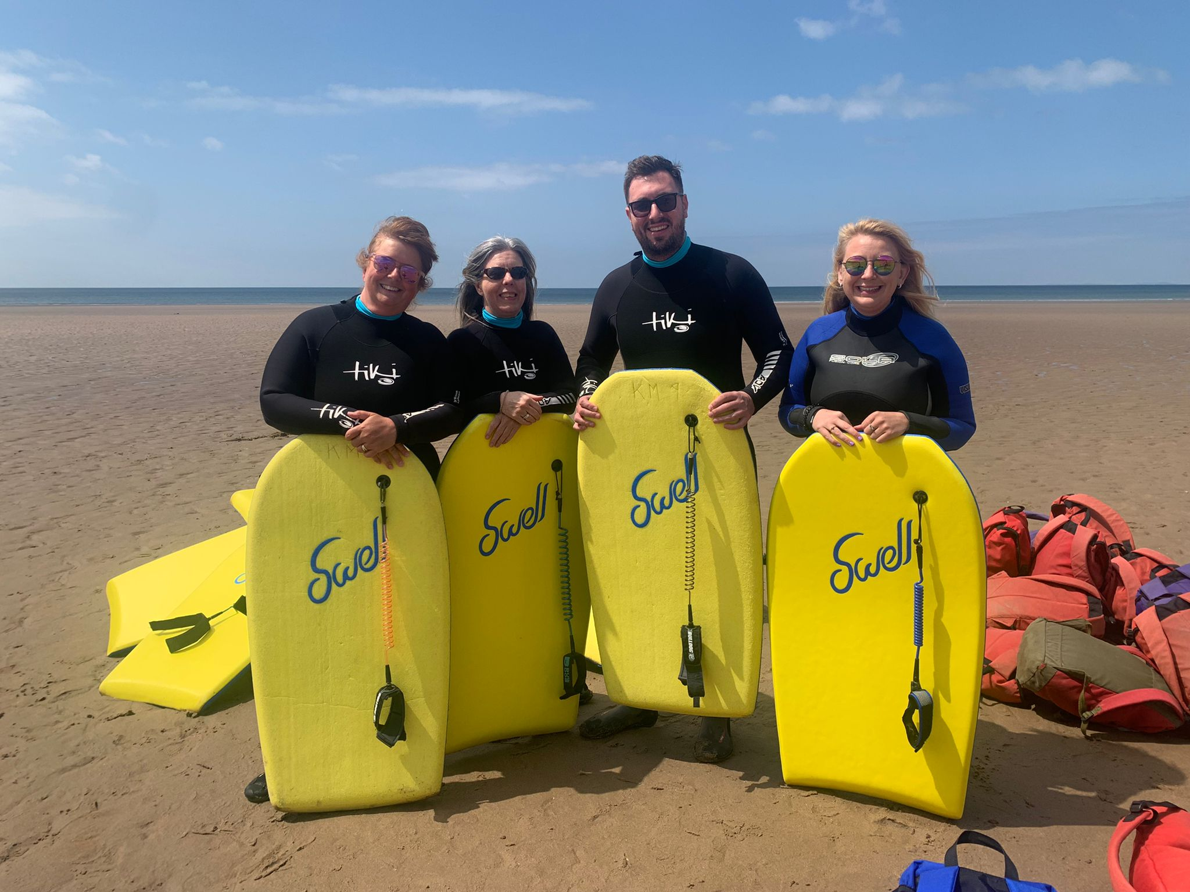
Your staff for the week:
Mr Donhou
Miss Brown
Mr Davies
Ms Spence
Mrs Noonan
Ms Painter
Ms Jordan
Mr Horne
Mr Howe
Mrs Knapp

Slide 3
Departure Timings
On Monday 22nd June, children need to arrive at school for 7.25am. This is for the scheduled coach departure of 8am. Please do not turn up before 7.15am as staff will be getting things ready!
Children should come to the front of the school and meet their class teachers on the meadow to be registered.
Hand any medication to Ms Spence.

Slide 4
What do children need to bring?
A kit list has already been sent home and will be on the school website. Please ignore the weather forecast and pack for all weathers.
Children will need to move their own cases so over-packing is not helpful! Please name EVERYTHING!
Everyone needs a packed lunch on the first day please.
No electronics, especially mobile phones. There is very little signal and children have no access to the limited wifi. We will confiscate phones!

Slide 5
Essential items that may get forgotten!
2 Water bottles
2 towels
Toothbrush
The right kind of bedding - fitted single sheet, single duvet cover and a pillow case. Please let us know if you need help with bedding.
Sun hat
Sun cream
Swimming costume
Indoor shoes (slip-on)
Bin bags/plastic bags for dirty/wet items

Slide 6
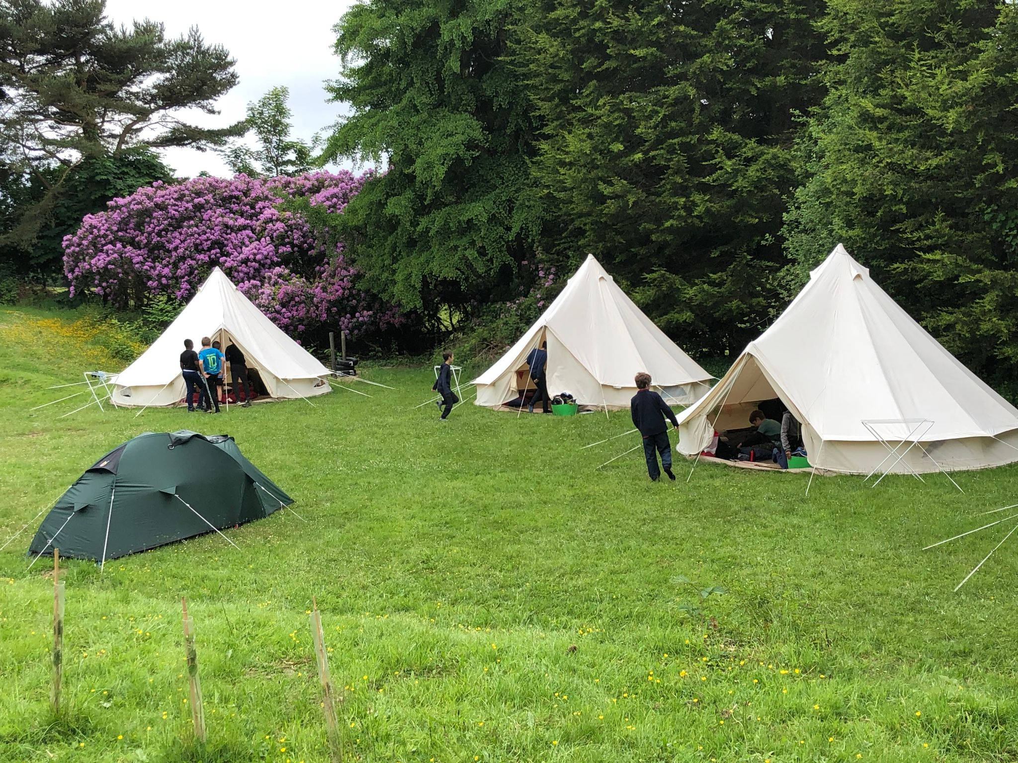
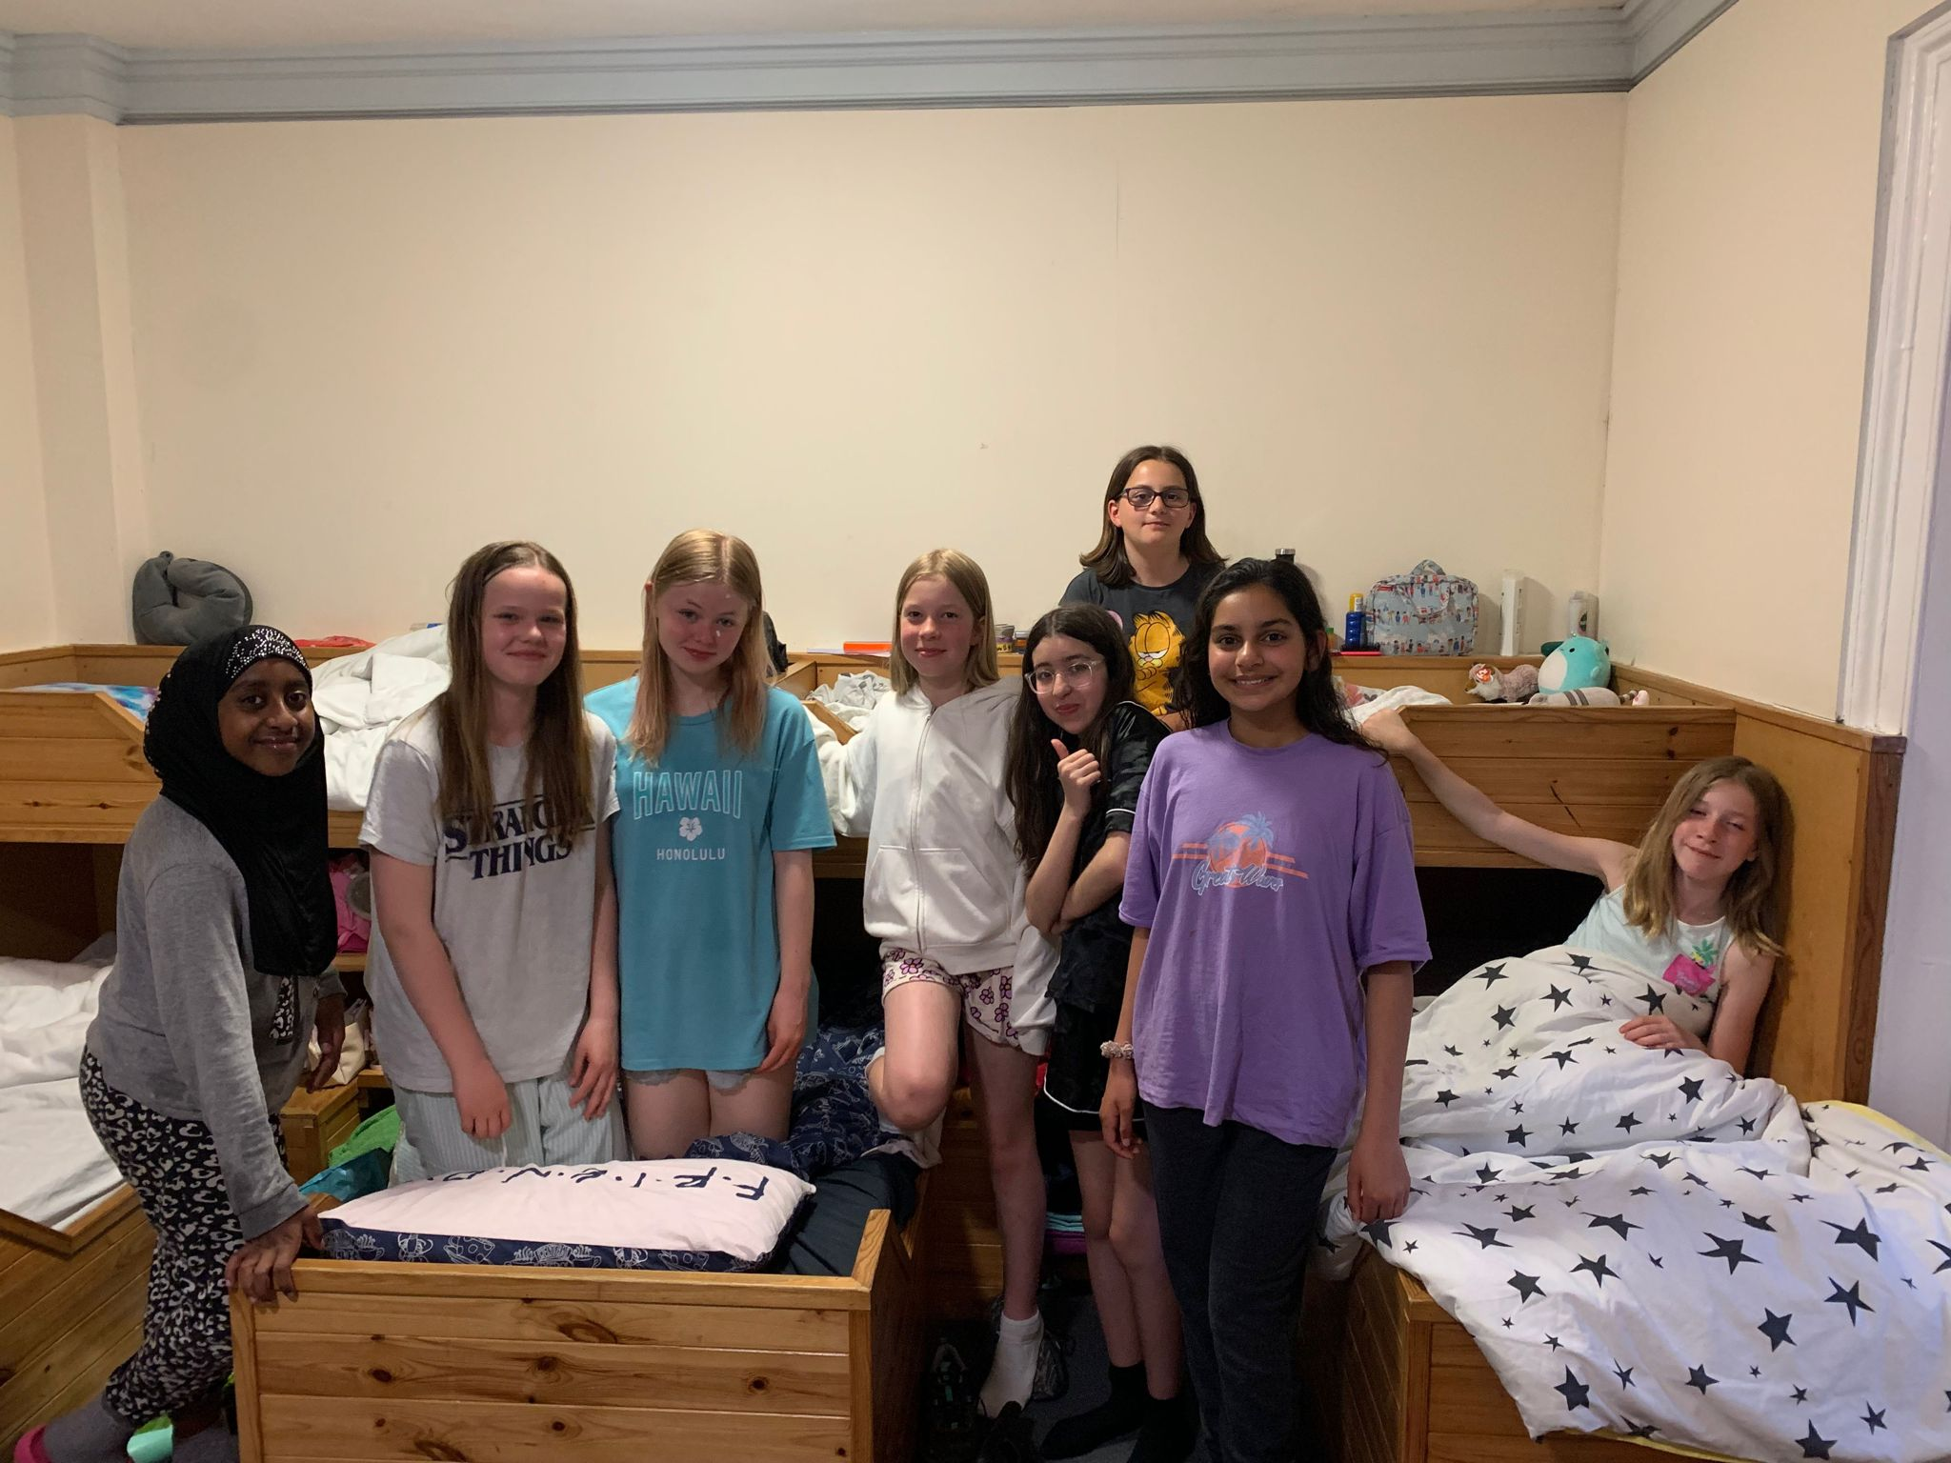
Dorm allocations
There are two options. Some children will be in dormitories in the main building. These range from 4 bed to 9 bed and are split boy/girl.
Others will be in tents outside. These are usually 7/8 person bell tents which will be next to the main building.
Staff will be in both locations.
For kit list purposes, you will know if your child is sleeping in a tent in advance. Arrangements are currently being made.
Notes:
ben

Slide 7
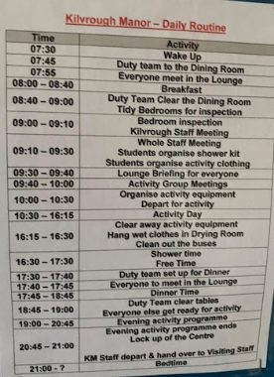
What is the daily timetable?
Times will vary each day but roughly…
Children up at around 7.30am
Breakfast and then into activity groups to prepare for the day
Out on activity from 10.30am until around 4-5pm depending on the activity
Dinner is at around 6-6.45pm
Evening activity
Bed! 9pm (varies across the week and generally gets earlier!)

Slide 8
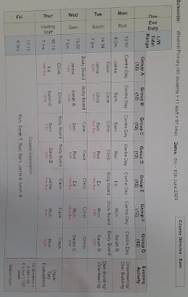
What will the children be doing?
Monday - Settling into tents/dorms, team building challenges and activities on site
Tuesday, Wednesday, Thursday - Rotation of caving, climbing/abseiling and watersports (body boarding and surfing).
Friday - Beach morning before lunch and coach back to Oxford
The timetable just shows that the activities vary across groups, but some groups will travel to the same venue for the day.
Notes:
ben

Slide 9
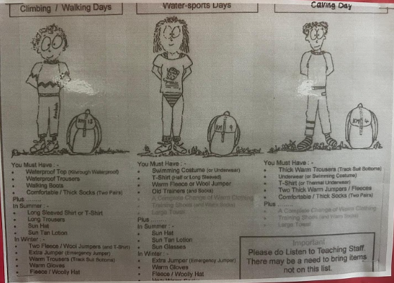
Here is an example of the kit list on the wall in the meeting room.
The children first meet in groups with their Kilvrough instructors to discuss the day ahead and then collect their resources to prepare for the day.

Slide 10
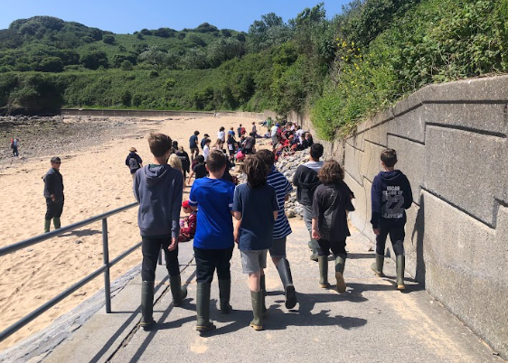
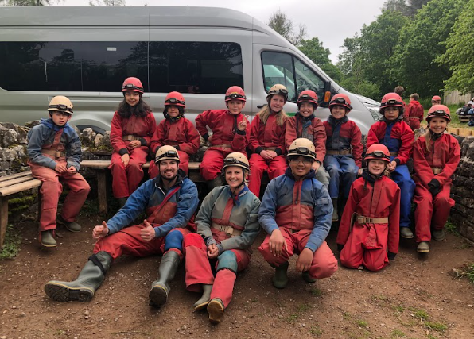
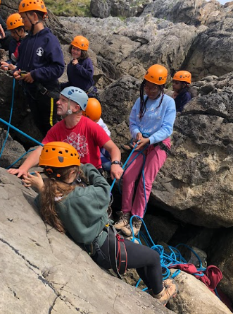
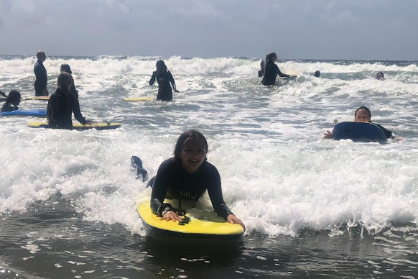
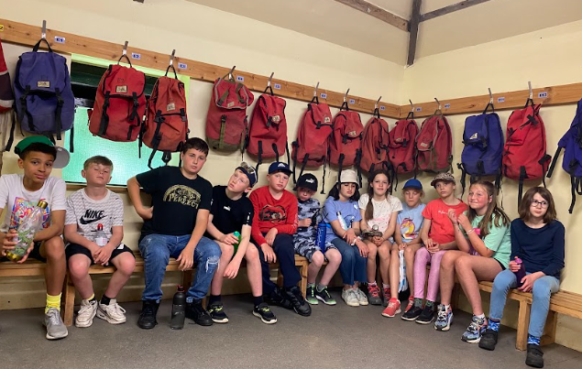
Examples of the activities

Slide 11
Communication and returning home?
Please follow us on Twitter/X :@WPSKilvrough(not the main school account)
You do not need to be on X to view the tweets
We will leave Kilvrough mid-afternoon and expect to be back in Oxford at around 6pm
All updates will be on Twitter, please follow along and spread information to all parents
Collecting on time is really important for your child but also the adults, everyone will be exhausted!

Slide 12
Letters going out today
Future Letters
Final payments and kit list
17th April- 1st May deadline
Souvenir shop letter
Administering medicine (Calpol permission)
15th May- 5th June deadline
Medical form (if needed) e.g. inhalers, travel sickness tablets, ect.

Slide 13

Birthdays
If your child has a birthday and you would like to have communication with them on that day, please contact your class teacher or Mr Donhou, so we can make arrangements. This will usually be in the evening, due to the busy schedule during throughout the day.
We’ve had friends that bring balloons and other party bits previously, and we set up time for a group of children to have a mini party in their dorms or in the meeting room.

Slide 14
Any questions?
How big does their luggage need to be?
There is no specific size, as long as they can carry it or (with support) get them up the stairs if they are staying in dorms. Not having to bring walking boots or wellies should help!

