Slide 1
Maths in Year 3 and 4

Slide 2
By Year 3, children should be fluent in adding numbers under 10 in their head. They also need to know how to cross the boundary of 10, e.g. 7 + 8.
Year 3 children add numbers up to 3 digits e.g 234 + 231
Year 4 children add numbers up to 4 digits e.g. 3,456 + 1,246
They are exposed to numbers in lots of different ways and are encouraged as much as possible to ‘see’ the numbers as what they are. E.g. the 5 in 657 is a 50.

Slide 3
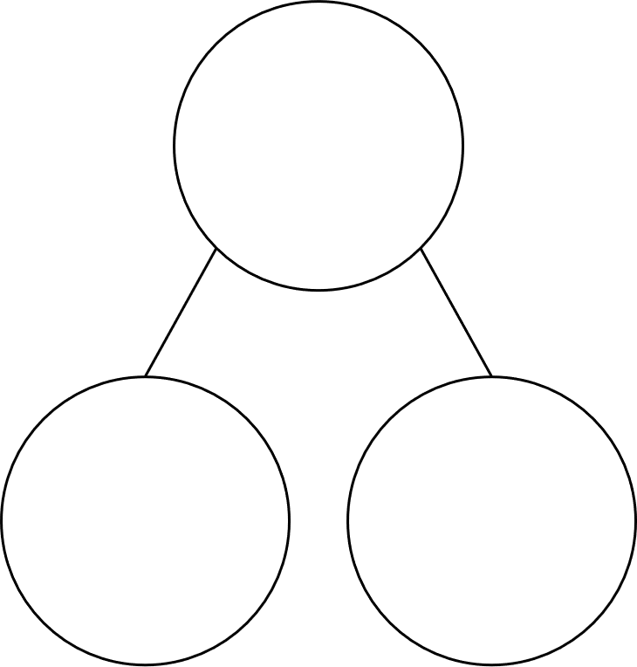
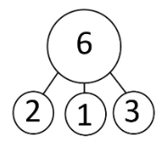
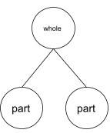
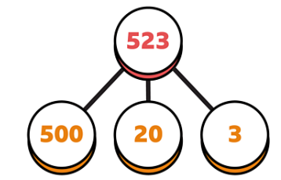
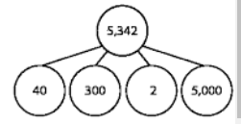
Part Part Whole
15
10
5

Slide 4
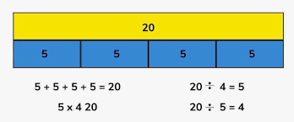
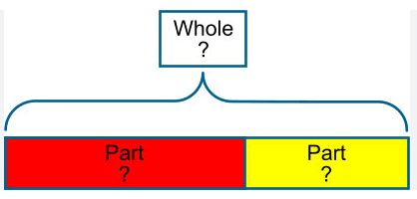
Bar Model
4 x 5 =20

Slide 5
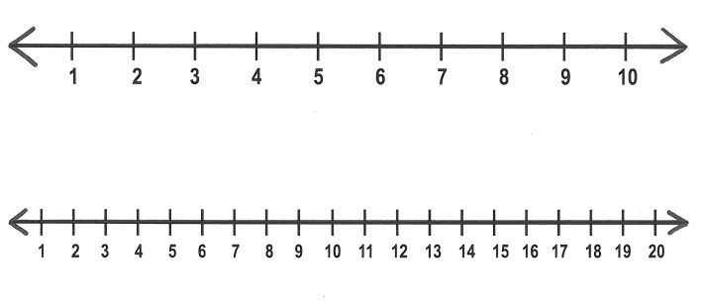
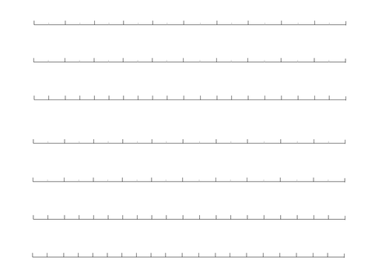
Number lines

Slide 6
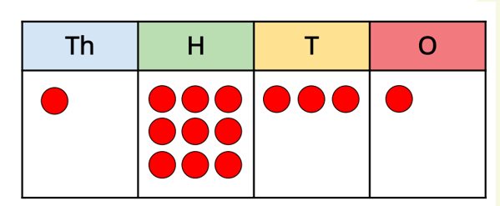
Place Value charts

Slide 7





Th | H | T | O
What number has been made?
1,245
Have a think
Subtract 2 ones from the number.
What number have you made?
1,243
Add 3 thousands to the number.
What number have you made?
4,245

Slide 8
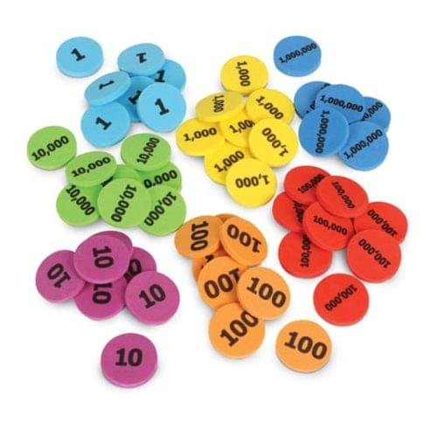
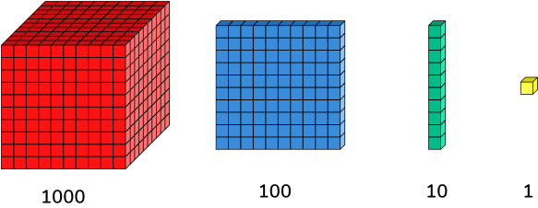
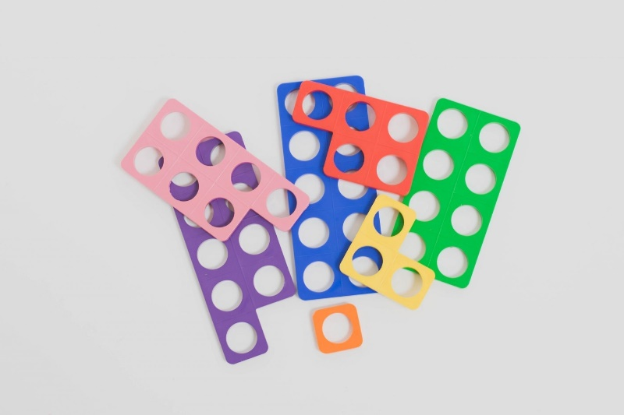
Maths Equipment

Slide 9
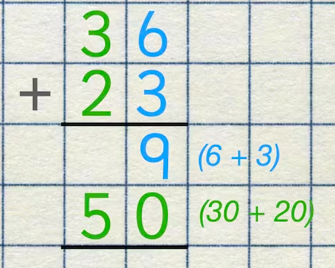
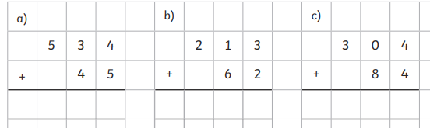

Slide 10
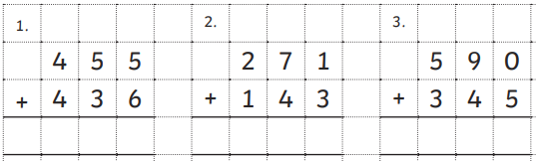
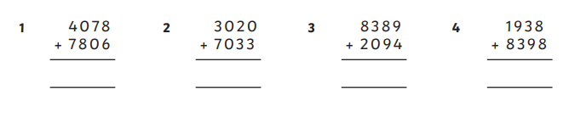
Regrouping

Slide 11
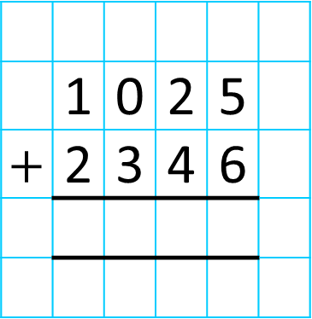
Th | H | T | O
 | 1 | 0 | 2 | 5
$+$ | 2 | 3 | 4 | 6
3
3
7
1
1
3
3
7
1

Slide 12
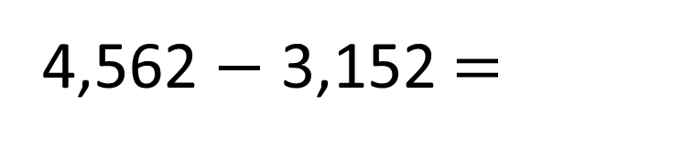
1,410
Th | H | T | O
 | 4 | 5 | 6 | 2
 | 3 | 1 | 5 | 2
1
4
1
0
1
4
1
0
Use your equipment to help you!

Slide 13
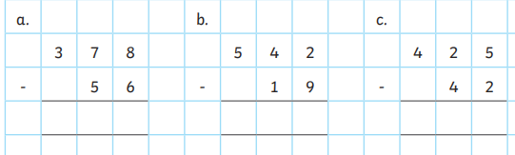
‘Exchanging’

Slide 14
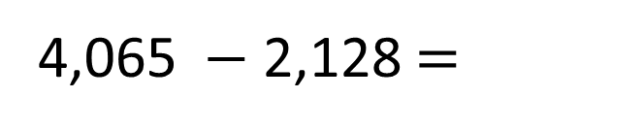
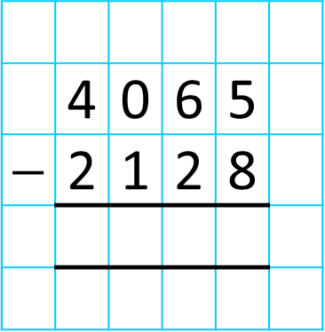
1,937
4,065 $−$ 2,128 $=$
Th | H | T | O
 | 4 | 0 | 6 | 5
$−$ | 2 | 1 | 2 | 8
3
1
5
1
1
9
3
7
1
9
3
7
ones
There are not enough , so I need to exchange 1 for 10
hundreds
ten
thousand
hundreds
ones

Slide 15
Children should leave Year 3 knowing their 1,2,3,4,5,8,10 times tables
Children should leave Year 4 knowing all of them.
They do a Multiplication Check in May/June time which expects them to know them all within 6 seconds.

Slide 16
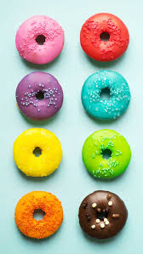
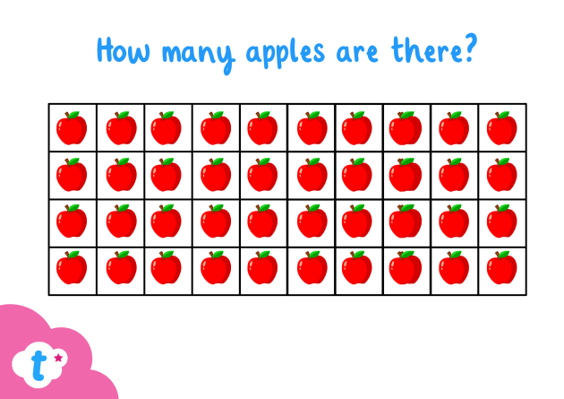
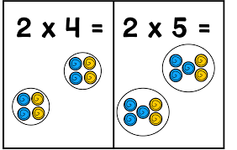
Array

Slide 17
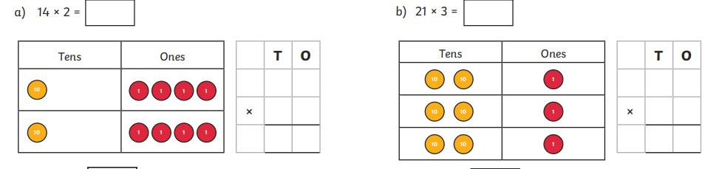

Slide 18
Thousands | Hundreds | Tens | Ones
3
8
0
3
8
0
38 × 10 =
Not adding a 0!

Slide 19
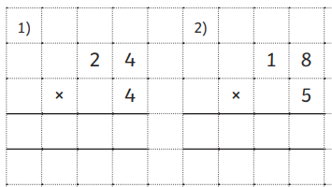

Slide 20
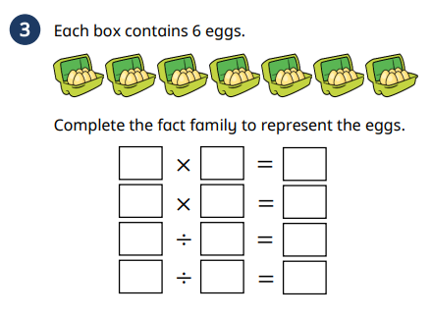
6 x 7 = 42

Slide 21






Have a think
$×$ 10
$×$ 10
$×$ 10
Thousands | Hundreds | Tens | Ones
$÷$ 10
$÷$ 10
$÷$ 10
What do you notice?

Slide 22
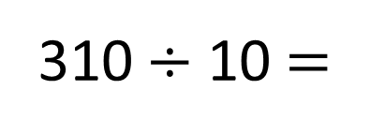
Hundreds | Tens | Ones
310 $÷$ 10 =
3
1

Slide 23
99 ÷ 3
? X 3 = 99
1 x 3 = 3
3 x 3 = 9
10 x 3 = 30
20 x 3 = 60
30 x 3 = 90

Slide 24
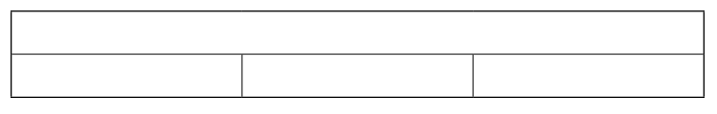
99 ÷ 3
99

Slide 25
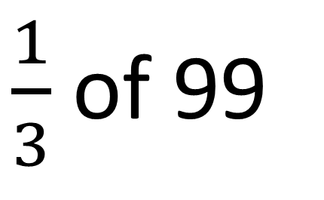
$\frac{1}{3}$ of 99
99

Slide 26


Slide 27
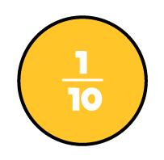
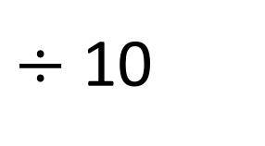
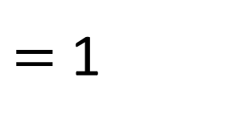

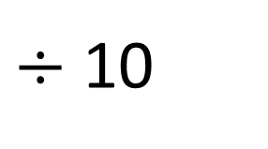
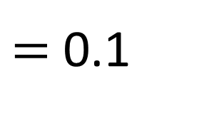
What number is represented here?
10
10
What number is represented here?
1
1

Slide 28
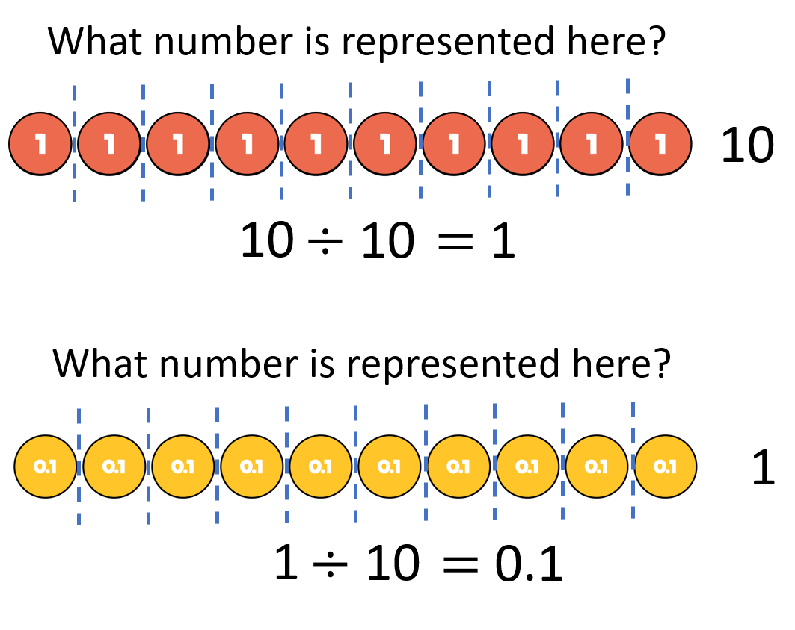
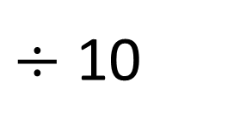
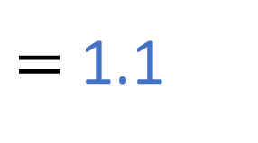
What number is represented here?
10
11
1
11

Slide 29
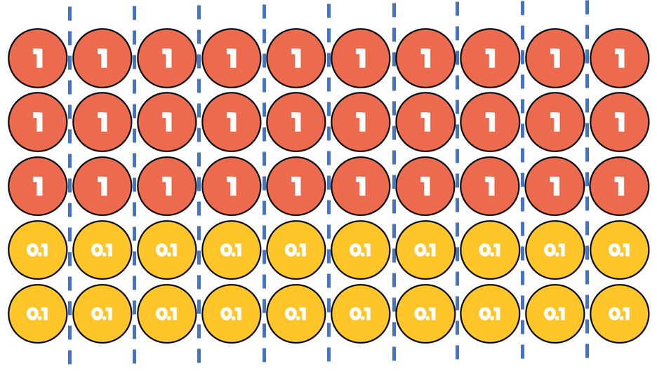
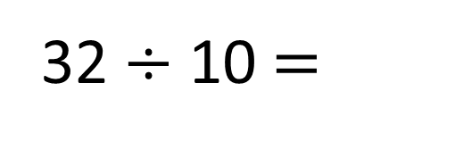
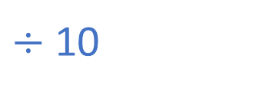
3.2
Tens | Ones | Tenths
Tens | Ones | Tenths

Slide 30
Any questions?

